Slide 1

Conversational AI: RBS Chatbot
Ahold Delhaize

Slide 2
Agenda
Conversational AI:NLU Chatbot for RBS Apps
Chatbot Implementation: Architecture
Sample Usecases

Slide 3
Why RBS Assistant (NLU Chatbot)?
Usage
Check the status without logging into RBS dashboard.
Interact using simple queries to get answers without referring to reports (Microstrategy reports).
PoC Scope
Job Info and few business queries
Extendable
We started with Datawarehouse which can be extended to other areas
Intents Trained
Trained 57 intents for PoC
Data Availability
Loyalty Card sales – 2 weeks data
Divisionwise sales – 1 day data
Daily sales – last 7 days
Fiscal week sales – last 7 weeks
Ad Week – last 7 week

Slide 4
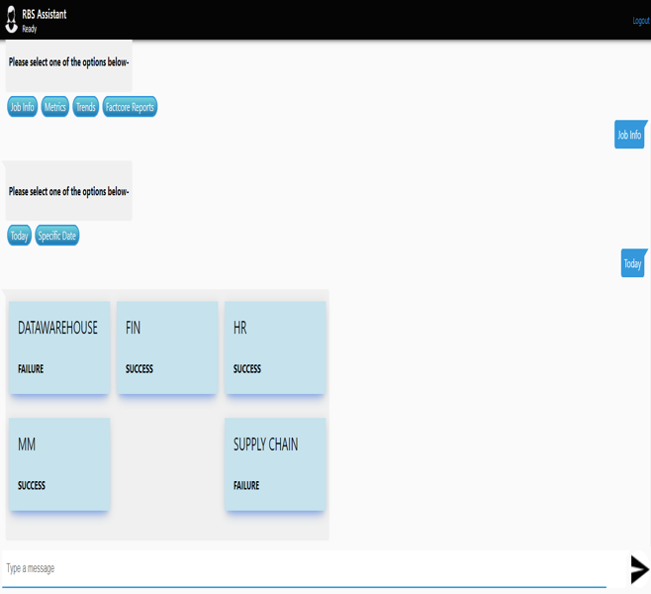
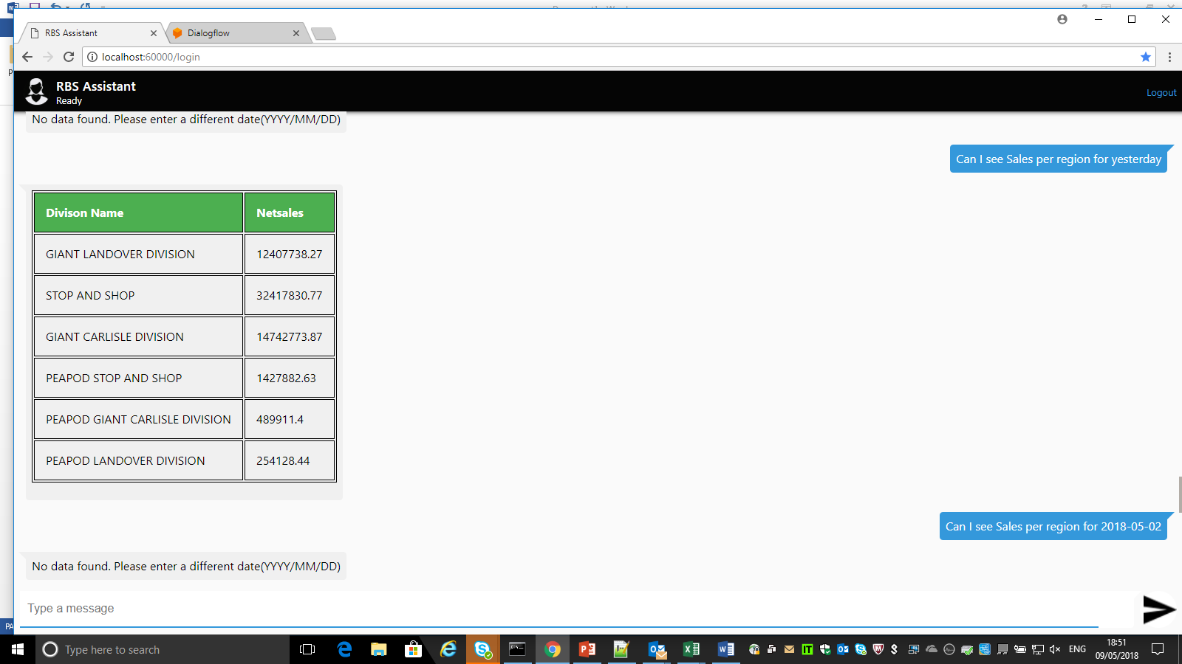
Conversational AI: NLU Chatbot for RBS Apps
* Implemented as part of proof-of-concept
Sample interaction: Job status of towers, Division sales etc.
Features:
Integrates with existing database, business systems and translate the data into voice or simple text interfaces*.
Sample conversation flow goals/outcomes: Job Info*, Business KPIs/metrics*, trends, reports, fix and issue, give feedback, trigger RPA flow .
Analytics (Usage Data, NLU Data) - Monitor, track the different command and responses of its users and consumer applications.
Provides security capabilities such as encryption, data privacy, and access control policies.
RBS Assistant
Conversation(NLU) as an interface
Engage with the user better – Interact in a much faster , intuitive manner
Reduced development time
Notes:
Contextual Analysis. We can easily teach the bot to understand intents and categorize in which scenario would the conversation fall into.
Customer Experience. We can develop bots using NLU services to improve the overall conversation experience with the bot (instead a simple rule-based approach).
Reduced development time. NLU services allow us to easily perform NLP techniques such tokenization and entity recognition with almost no code writing required.

Slide 5



Chatbot Implementation: Architecture
Recommended for Ahold Delhaize: Passthrough Chatbot
Dialogflow.ai [Api.ai] Platform – NLP and Dialog Designer
NLP/Dialog Flow over http outbound connection
Fulfilment Services
Data Flow In The Intranet or Corporate Network
DXC IP
Data or Actions
Passthrough Webchat Server
RBS Database
User DB/LDAP/3rd party authentication provider
Process
Dialog Manager Channel Connector
Build
The
conversation
Integrations
Training
1
2
3
4
Dialog manager – dialog state & strategy, library of actions (what a chatbot can do for customer). Identify key usecases and design conversational experience using dialog designer
Channel connector that communicates with customers over different channels;
Conversational scenario designer – scenario design tool
inter-conversation memory – customers history , facts, preferences gained from previous sessions for personalized conversation.
2. Conversational flow prototype – testing and feedback from clients
3. Webhook enablement for integration with external APIs and systems to deliver actionable data in response to query in the conversation.
4. Supervised learning to train the algorithm.
Add more conversation flows and optimize over time by collecting and labeling more interaction data to make the chatbot conversationally smart.

Slide 6

Sample queries – Business Data
I. | DIVISIONWISE SALES
1 | Which region had maximum sales yesterday?
2 | Which region had minimum sales yesterday?
3 | show me the sales for PEAPOD GIANT CARLISLE DIVISION yesterday
II | Loyalty Cards Weekly Sales
1 | What is the percentage change in phantom cards sales from last week?
2 | What is the sales amount for Manager Override for last Saturday
III | ADWEEKLY SALES
1 | Please help me with the discount amount per ad week for last 7 weeks
2 | Total gross dollar for last 2 ad weeks
IV | WEEKLY SALES
1 | Show me the discount amount per Fiscal week
2 | Which fiscal week clocked the highest sale this month?
V | DAILY SALES
1 | Show me the net sales in the last five days
Note – trained 57 intents for PoC
Data:
Loyalty Card sales – 2 weeks data
Divisionwise sales – 1 day data
Daily sales – last 7 days
Fiscal week sales – last 7 weeks
Ad Week – last 7 week

Slide 7
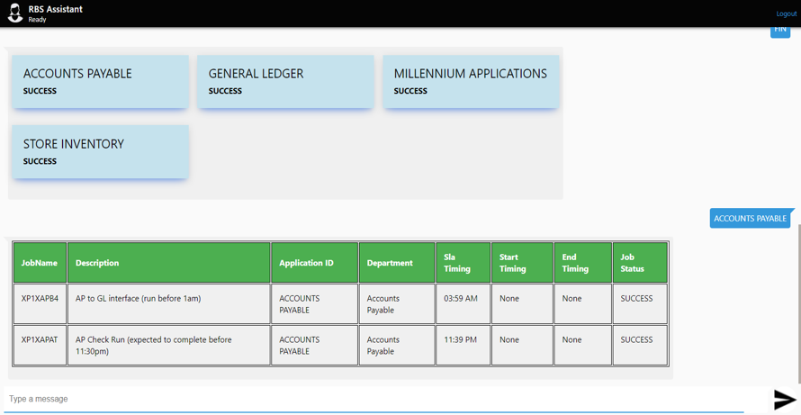
Sample Sequence – Job Info
Hi there! This is your RBS Assistant. I can help you with Job Info, business KPIs/Metrics, trends, reports etc. Please type 'Help' at any time, for assistance - Happy to help.
Cards (buttons) with drill down
Show me Finance job status

